Slide 1
Generalization
TDT17 - Sept. 10th, 2019
Erik Liodden, Simen Ullern and Vebjørn Fjeldberg

Slide 2
Table of Contents
Generalization: what is it, and why?
Overfitting and underfitting
How to measure generalization
How to generalize your model - Preparing your dataset - Regularization
Summary

Slide 3
What is generalization?
Generalization refers to your model's ability to adapt properly to new, previously unseen data, drawn from the same distribution as the one used to create the model.
https://developers.google.com/machine-learning/crash-course/generalization

Slide 4

Why is this difficult? The fundamental problem of ML
Stochastic input data X ⇒ stochastic output as well
What parts of the input is relevant? Can it be found with statistical induction techniques using only a subset of the data?
Algorithms that create algorithms need some unknown optimal structure function
Notes:
The problem with generalization is closely related to the fundamental problem of machine learning.
This is machine learning. We have some input data x, and the goal is to find some algorithm A that can map x to the correct thing (whatever it is), with the result laying in some hypothesis space under consideration.
This leads us to the problem of validation. How can we be sure that our algorithm A is the best one for all cases of x, when we only have access to a limited part in our dataset?

Slide 5
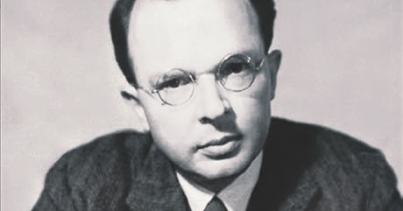
Rudolf Carnap
The problem of induction poses the question: “What justifies us in going from the direct observation of facts to a law that expresses certain regularities of nature?”
Notes:
In science in general, deduction is much better understood than induction.
Deduction is about finding new theories from old theories.
Induction is about finding theories from data. This is what we do in machine learning, we try to seek conclusions from particular cases to the general case.

Slide 6
One approach to achieve generalization
Partition the dataset into training, validation and testing.
The model is trained on the training set
The validation set is tested upon regularly during training and used to tune the hyperparameters of the model
Test set is only used at the end to give an indication about how well the model is generalizing
Notes:
To be able to test how well the model is generalizing, it is necessary to partition the dataset into a training set and a testing set. The testing set should not be looked at until the very end, and is used for benchmarking purposes only. It is the error on the testing set that is the “real” error of the model.
During training, it is useful to partition the training data into a training set and a validation set. The validation set is tested upon at each epoch, and is used to tune the hyperparameters of the model (i.e. parameters related to the model, not the data).

Slide 7

What happens if you peek on test data?
Test data cannot be used before the final estimator has been selected!
If we use test data for validation, then estimator adaptation introduces statistical dependencies between outcome of the learning process (estimator) and test data. This design flaw yields a too optimistic estimate of the test error.
Notes:
The number one pitfall for constructing a model that cannot generalize well is to peek on test data

Slide 8
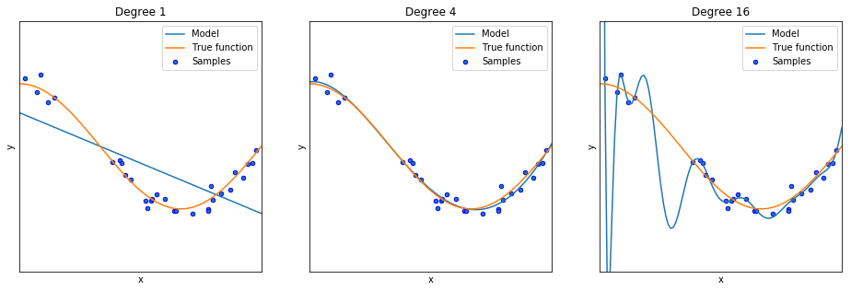
2. Overfitting and underfitting
Occam's razor: when presented with competing hypotheses that make the same predictions, one should select the solution with the fewest assumptions.
Notes:
Overfitting:
The model “remembers” the training cases and do not generalize well.
The solution is generally too complex than the model you want to find (e.g. a polynomial of a degree that is too large than what the underlying data suggests)
Might be because you are trying to fit to many parameters given the amount of data, or that the model is too complex to capture the underlying structure of the dataset.
Underfitting:
The opposite of overfitting, the model is usually too simple (e.g. a polynomial of a degree that is too low)
Might be because the model structure is too simple or because the training is terminated too early

Slide 9
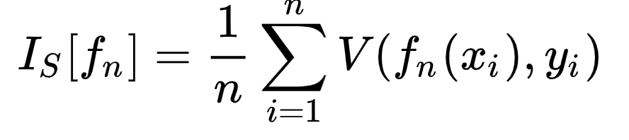
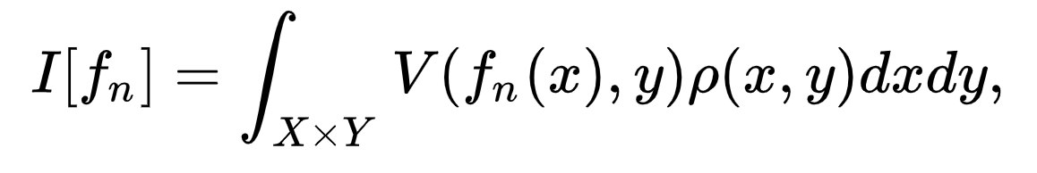
Distinguish between expected and empirical error
Empirical error can easily be measured on some test set
But the expected error or risk is the quality measure which we ultimately care about because it is calculated over all possible values
where V denotes a loss function and p(x,y) is the unknown probability distribution
Notes:
This is also called risk because it is the expectation of the loss function.

Slide 10
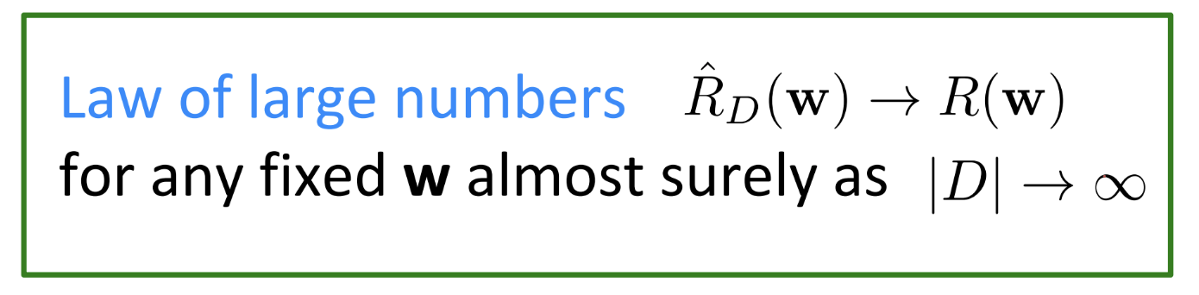
Estimating the generalization error
Estimate the true error by the empirical error on a sample data set D
Why might this work?
ssSdd
Notes:
So this is what we do. We estimate the true risk by the empirical risk on a test set, and then we hope for the best

Slide 11
Generalization in general
The generalization error is the difference between the expected and empirical error.
An algorithm is said to generalize if the generalization error approaches 0 as the number of data points goes to infinity.

Slide 12
How to generalize your model
preparing your dataset and regularization
Notes:
So again, the goal of machine learning is to model the pattern in the training data and ignore the noise. If the ML algorithm also tries to model the noise it can be overfitted. Therefore there are a lot of techniques that prevent this from happening, and we will now show you some of them.
We will focus on two types of techniques; data preparation techniques and regularization techniques.
Data preparation is something you do with the data before you start to train the model, and it is an important step to generate insights in the data. This may also be the most time-consuming part of a ML problem, and the goal is to enrich the data, transform it and improve the accuracy of the outcome
Regularization is a technique used to avoid the overfitting problem

Slide 13
Preparing your dataset
Attribute sampling: assume which attributes are critical and which are going to add more dimensions and complexity to your dataset without any predictive contribution.
Record sampling: remove less representative records to make prediction more accurate.
Data normalization: change values of attributes in the dataset to common scale, without distorting differences in the ranges of values
Data augmentation: Increase the diversity of the dataset used for training by generating new data. In image classification, this can be done by rotating and mirroring images and adding noise etc.
Notes:
In a lot of ML problems you know the attribute you want to predict, and since you do that you can assume which attributes that are critical and which that are going to add more dimensions and complexity to your dataset without any predictive contribution, and can therefore be removed. This is known as attribute sampling
With record sampling you remove less representative records to make prediction more accurate.
Data normalization changes values of attributes in the dataset to a common scale, without distorting differences in the ranges of values. This is not always necessary, but many classifiers use for instance the Euclidean distance to calculate the distance between two points. If one attribute then has a broader range of values than other attributes, the distance will be governed by this particular attribute
With data augmentation you increase the diversity of the dataset used for training by generating new data. In image classification, this can be done by rotating and mirroring images and add noise etc. You then get more data to train on, which is a good thing to prevent overfitting.

Slide 14
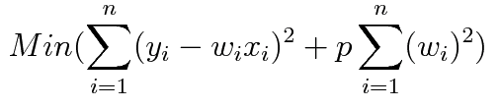
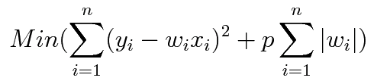
Regularization techniques
Dropout: a technique used in DL where randomly selected neurons are ignored during training
L2:
L1:
Notes:
Now look at some regularization techniques
The first one is called dropout which is a technique used in DL, where randomly selected neurons are ignored during training. All the neurons then get more dependent which improves generalization.
L1 and L2 are two regularization techniques that add a penalty to the cost function. The penalty in L2 is the sum of squared values of weights, while it is the sum of the absolute values of weights in L1
Without going into the mathematical aspects of these methods, you can say that L1 shrinks the less important feature weights to zero and produces a model that is simple and contains a subset of input features. L2 regularization forces the weights to be small but does not make them zero and performs better when all the input features influence the output

Slide 15
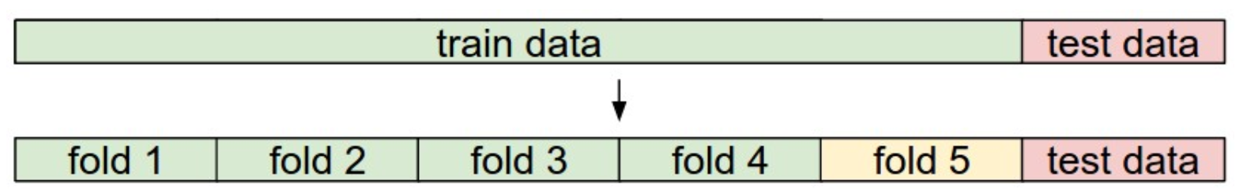
K-fold cross-validation
Useful to shuffle around the validation data. This usually helps the model to generalize better.
Split the training data into different folds and alternate which fold is used as validation set.
http://cs231n.github.io/classification

Slide 16
No free lunch theorem
The no free lunch theorem states that there is no one model that works best for every problem. The assumptions of a great model for one problem may not hold for another problem.
One must always assess trade-offs between speed, accuracy and complexity in practical ML problems.

Slide 17
Summary
Minimize error, maximize generality
Prepare your dataset properly and regularize to avoid too optimistic estimates
Partition your dataset into a training set and testing set. A validation set can be used to guide estimator selection. Estimate the true error by the empirical error on your test set
Unless you have limited computational power, you have no excuse not to do cross validation
Be aware of the tradeoffs that you either explicitly or implicitly have to make

